Slide 1
Chapter one
The Fundamental Physical Quantities

Slide 2
Acoustics: the study of systems that produce and propagate sound
Distance: spatial separation of two points
Length: the measurement of distance
Displacement: move an object from one place to another
Magnitude: amount of displacement in some unit of length
Vector quantity: quantities that involve direction and magnitude
Example: displacement
Sense of displacement: positive or negative direction
Derived units: new units out of old
Example: area is derived from length
Velocity: rate at which the object’s displacement changes (involves direction and magnitude, so is a vector quantity)

Slide 3
Speed: magnitude of velocity (meters per second, kilometers per hour)
Acceleration: rate at which velocity changes (also a vector quantity)(meters per second squared)
Mass: ‘amount’ of matter (in grams)
Force: a push or pull that produces distortion or acceleration; always occurs in pairs
Example: gravity
Distortion: effect of force that alters the shape of an object
Elasticity: capacity in which objects get distorted
Weight: force of gravity acting on a mass
Equilibrium: when two forces cancel each other
Friction: opposite force exerted by lack of smoothness

Slide 4
The magnitude of acceleration is proportional to the magnitude of force
Acceleration is inversely proportional to mass
Up to constants of proportionality, this means $F=Ma$

Slide 5
Newton: unit of force corresponding to the acceleration of 1kg of mass by 1m/s²
Momentum: tendency of a mass in motion to remain in motion
Pressure: amount of force acting on an area (in n/m²)
Example: ambient(atmospheric) pressure, tire pressure in lb/in²
Sound: small and rapid changes in ambient pressure
Work: force times the distance moved in the same direction as the force
Joule: unit of work corresponding (in n/m)
Energy: saving (potential energy) or expending (kinetic energy) work
Power: rate at which work is done
Watt: one joule per second

Slide 6
Chapter two
Simple Vibrating Systems

Slide 7
Restoring force: results from an object being displaced from point of equilibrium and is proportional to the displacement
Amplitude: distance from the equilibrium position to a point of maximum displacement
Cycle: one complete excursion from a point through both points of maximum displacement and back in the original direction
Period: time in seconds required for one cycle
Frequency: number of cycles performed in one second; proportional to the square root of the mass

Slide 8
Simple harmonic motion: oscillatory motion obtained when the restoring force is proportional to the displacement
Phase: fraction of a cycle that has been covered according to some starting point
Sinusoid: curve described by a perfect harmonic motion
Decay: gradual dissipation of energy into heat
Envelope: curve of decay consisting of an initial transient, steady state and decay
Damping resistance: part of the system that absorbs energy, such as friction with air

Slide 9
Chapter three
Waves and Wave Propagation

Slide 10
Medium: material filling the intervening space where vibrations are transmitted
Density: mass of a unit amount of the medium in kg/m, kg/m² or kg/m³
Impulse: sudden and short disturbance in the medium
Propagation: when disturbance travels through the medium
Longitudinal disturbance: when the displacement of successive masses occur in the same direction the disturbance is traveling
Transverse disturbance: when this displacement is perpendicular to the direction the disturbance is traveling; only possible in solids
Wave: periodic disturbances following one another through the medium; can also be transverse (wave train) or longitudinal

Slide 11
Tension: magnitude of the force acting on a pulled string (an acoustic system)
Air column: air contained in a tube (another acoustic system)
Compressible medium: when increasing pressure decreases volume; air is a compressible medium
Rarefactions: regions where air molecules are pulled apart
Compressions: regions where air molecules are pushed together
Sound wave: longitudinal wave traveling through compressions and rarefactions in the air
Sound pressure: amplitude of the pressure variation in a sound wave above and below the ambient pressure
Wave amplitude: same as source for amplitudes that are not too large
Wave frequency: same as source provided neither source or receptor are moving too fast relatively to each other

Slide 12
Wave speed: independent of frequencies and amplitudes that are not too large and given by the square root of tension over density in Newtons per kg/m
Wavelength: distance comprised by one period; in particular, $S=f⋅λ$
Wave front: visual representation of a two-dimensional wave
Plane waves: straightened out wave fronts by distance from source
Speed of sound: in a gas medium is given by $c=\sqrt{\frac{γ⋅p}{ρ}}$, where gamma is a constant (for air $γ=1.4$), $p$ is the pressure and $ρ$ is the density in kg/m³; sound in air travels at a speed of 331.5 m/s in standard conditions; since pressure and density are proportional, the speed of sound does not depend on ambient pressure
Doppler effect: frequency shift that occurs when the source producing waves and the observer measuring waves are moving relative to one another; when moving toward each other frequencies get faster and vice-versa

Slide 13
Reflection: occurs when the properties of the medium change suddenly at a boundary such as a wall
Incident wave: wave moving toward the wall
Image: phantom source that appears to be as far behind the wall as the source is in front
Echo: delayed reflected waves
Focus: region where a sound concentrates
Example: if a wall is concave, the wave front may get curved
Refraction: change of direction caused by changes in the properties of a medium, such as temperature
Diffraction: ability of waves to go around corners
Example: hearing through doors

Slide 14
Interference: superposition of waves is additive, so they may reinforce (constructive interference) or weaken or even cancel out each other (destructive interference)
Beats: when two waves with slightly different frequencies interfere with each other; results in a new frequency that is the average of the the original frequencies with amplitude modulated by their difference
Radiation: when energy is carried away from a vibrating source through a medium
Efficiency: acoustic watts over watts supplied
Sound intensity: amount of power passing through each unit area of a measuring device; proportional to the square of sound pressure in one direction; given in w/m² by $I=\frac{p}{4πr^{2}}$
Sound absorption: walls that are not completely rigid absorb some energy from sound waves; usually does not depend on intensity

Slide 15
Chapter FOUR
Complex Vibrations and Resonance

Slide 16
Standing waves: so named because they appear not to be moving; practically all instruments produce them; consist of nodes, antinodes and loops
$d\left(N,A\right)=\frac{1}{2}λ$
If the length of the string in meters is $L$, then
$S=f⋅λ$
$λ_{1}=2L$, thus $f_{1}=\frac{S}{2L}=\frac{1}{2L}\sqrt{\frac{T}{ρ}}$, where $T$ is the tension in Newtons and $ρ$ is the mass in kg/m
$λ_{2}=L$, thus $f_{2}=\frac{S}{L}=2\frac{S}{2L}=2f_{1}$
$λ_{3}=\frac{2}{3}L$, thus $f_{1}=3\frac{S}{2L}=3f_{1}$
We call $f_{1}$ the fundamental frequency, $f_{n>1}$ harmonics, and refer to the overall phenomenon as vibration modes

Slide 17
Impulse traveling on a string: reflections are mirrored; the impulse travels the length $L$ at speed $S$ twice (back and forth); the time $T$ for a roundtrip is $\frac{2L}{S}$ and therefore $f_{1}=\frac{S}{2L}$; producing two impulses at half the time (twice the frequency) creates a node (cancellation) at the center of the string
Complex string vibrations: all modes are present, with relative amplitude depending on the point the string was plucked; can be verified by extracting harmonics; touching the string at an antinode stops all vibrations; plucking the string at a node removes the associated mode
Vibrations on air columns: also produce standing waves, only with longitudinal waves; nodes are compressions, antinodes are rarefactions; at open ends, where the pressure gets closer to the ambient pressure, amplitudes approach zero, creating pressure nodes, or displacement antinodes
Impulse traveling on an open tube: hitting one end with palm of hand produces an impulse (air compression), which expands into surrounding air at the other end of the tube, extends too far because of air’s inertia, leaving behind a rarefaction

Slide 18
Closed tubes: have one end closed; have displacement nodes at one side and pressure nodes at the open end; the length of the tube is a fourth of the wave length, thus
$f_{1}=\frac{S}{4L}$
$\frac{λ_{2}}{2}=\frac{2}{3}L⟺f_{2}=3\frac{S}{4L}=3f_{1}$
$\frac{λ_{3}}{2}=\frac{2}{5}L⟺f_{3}=5\frac{S}{4L}=5f_{1}$
Impulse traveling on a closed tube: when the impulse reaches the closed end, since the displacement there must be zero, it is reflected in an inverted fashion; now compression is not inverted (into rarefaction) when reflected; even modes cancel out, so only odd modes are possible
Conical air columns: cones have essentially the same vibration modes as open tubes
Puncturing holes in tubes that carry air columns produces inharmonic spectra

Slide 19
Metal bars: work the same way as open air columns; when both ends are free, these work as displacement antinodes; if the bar is clumped at the center, only odd harmonics are produced, as that point becomes a node
Stiff metal bars: the speed of a wave along a stiff bar is not independent of the frequency, producing inharmonic spectra (like bells)
Membranes: also have vibration modes, but instead of nodes they have nodal lines; these lines can be observed by sprinkling some thin powder on top of a membrane; the spectrum is mostly inharmonic
plates: have even more complicated modes than membranes (top of a violin)
Radiation: communication of a vibration (to a certain degree) to the surrounding air; larger areas such as soundboards radiate much better than strings or prongs; tubes radiate well in spite of not being efficient

Slide 20
Resonance: when a system that can vibrate at a certain frequency is acted upon by a periodic external disturbance (excitation) at the same frequency, producing vibrations of large amplitude
Examples: pendulums, swings, tuning forks over the same board and pretty much everything resonates
Helmholtz resonators: use resonance to amplify (as a means of filtering) frequencies corresponding to that of the resonator’s bottle
Logarithmic scales: are essential to understanding the human perception of frequency and amplitude; decibels and pitch classes are logarithmic scales

Slide 21
Chapter Five
The Ear: Intensity and Sound Levels

Slide 22
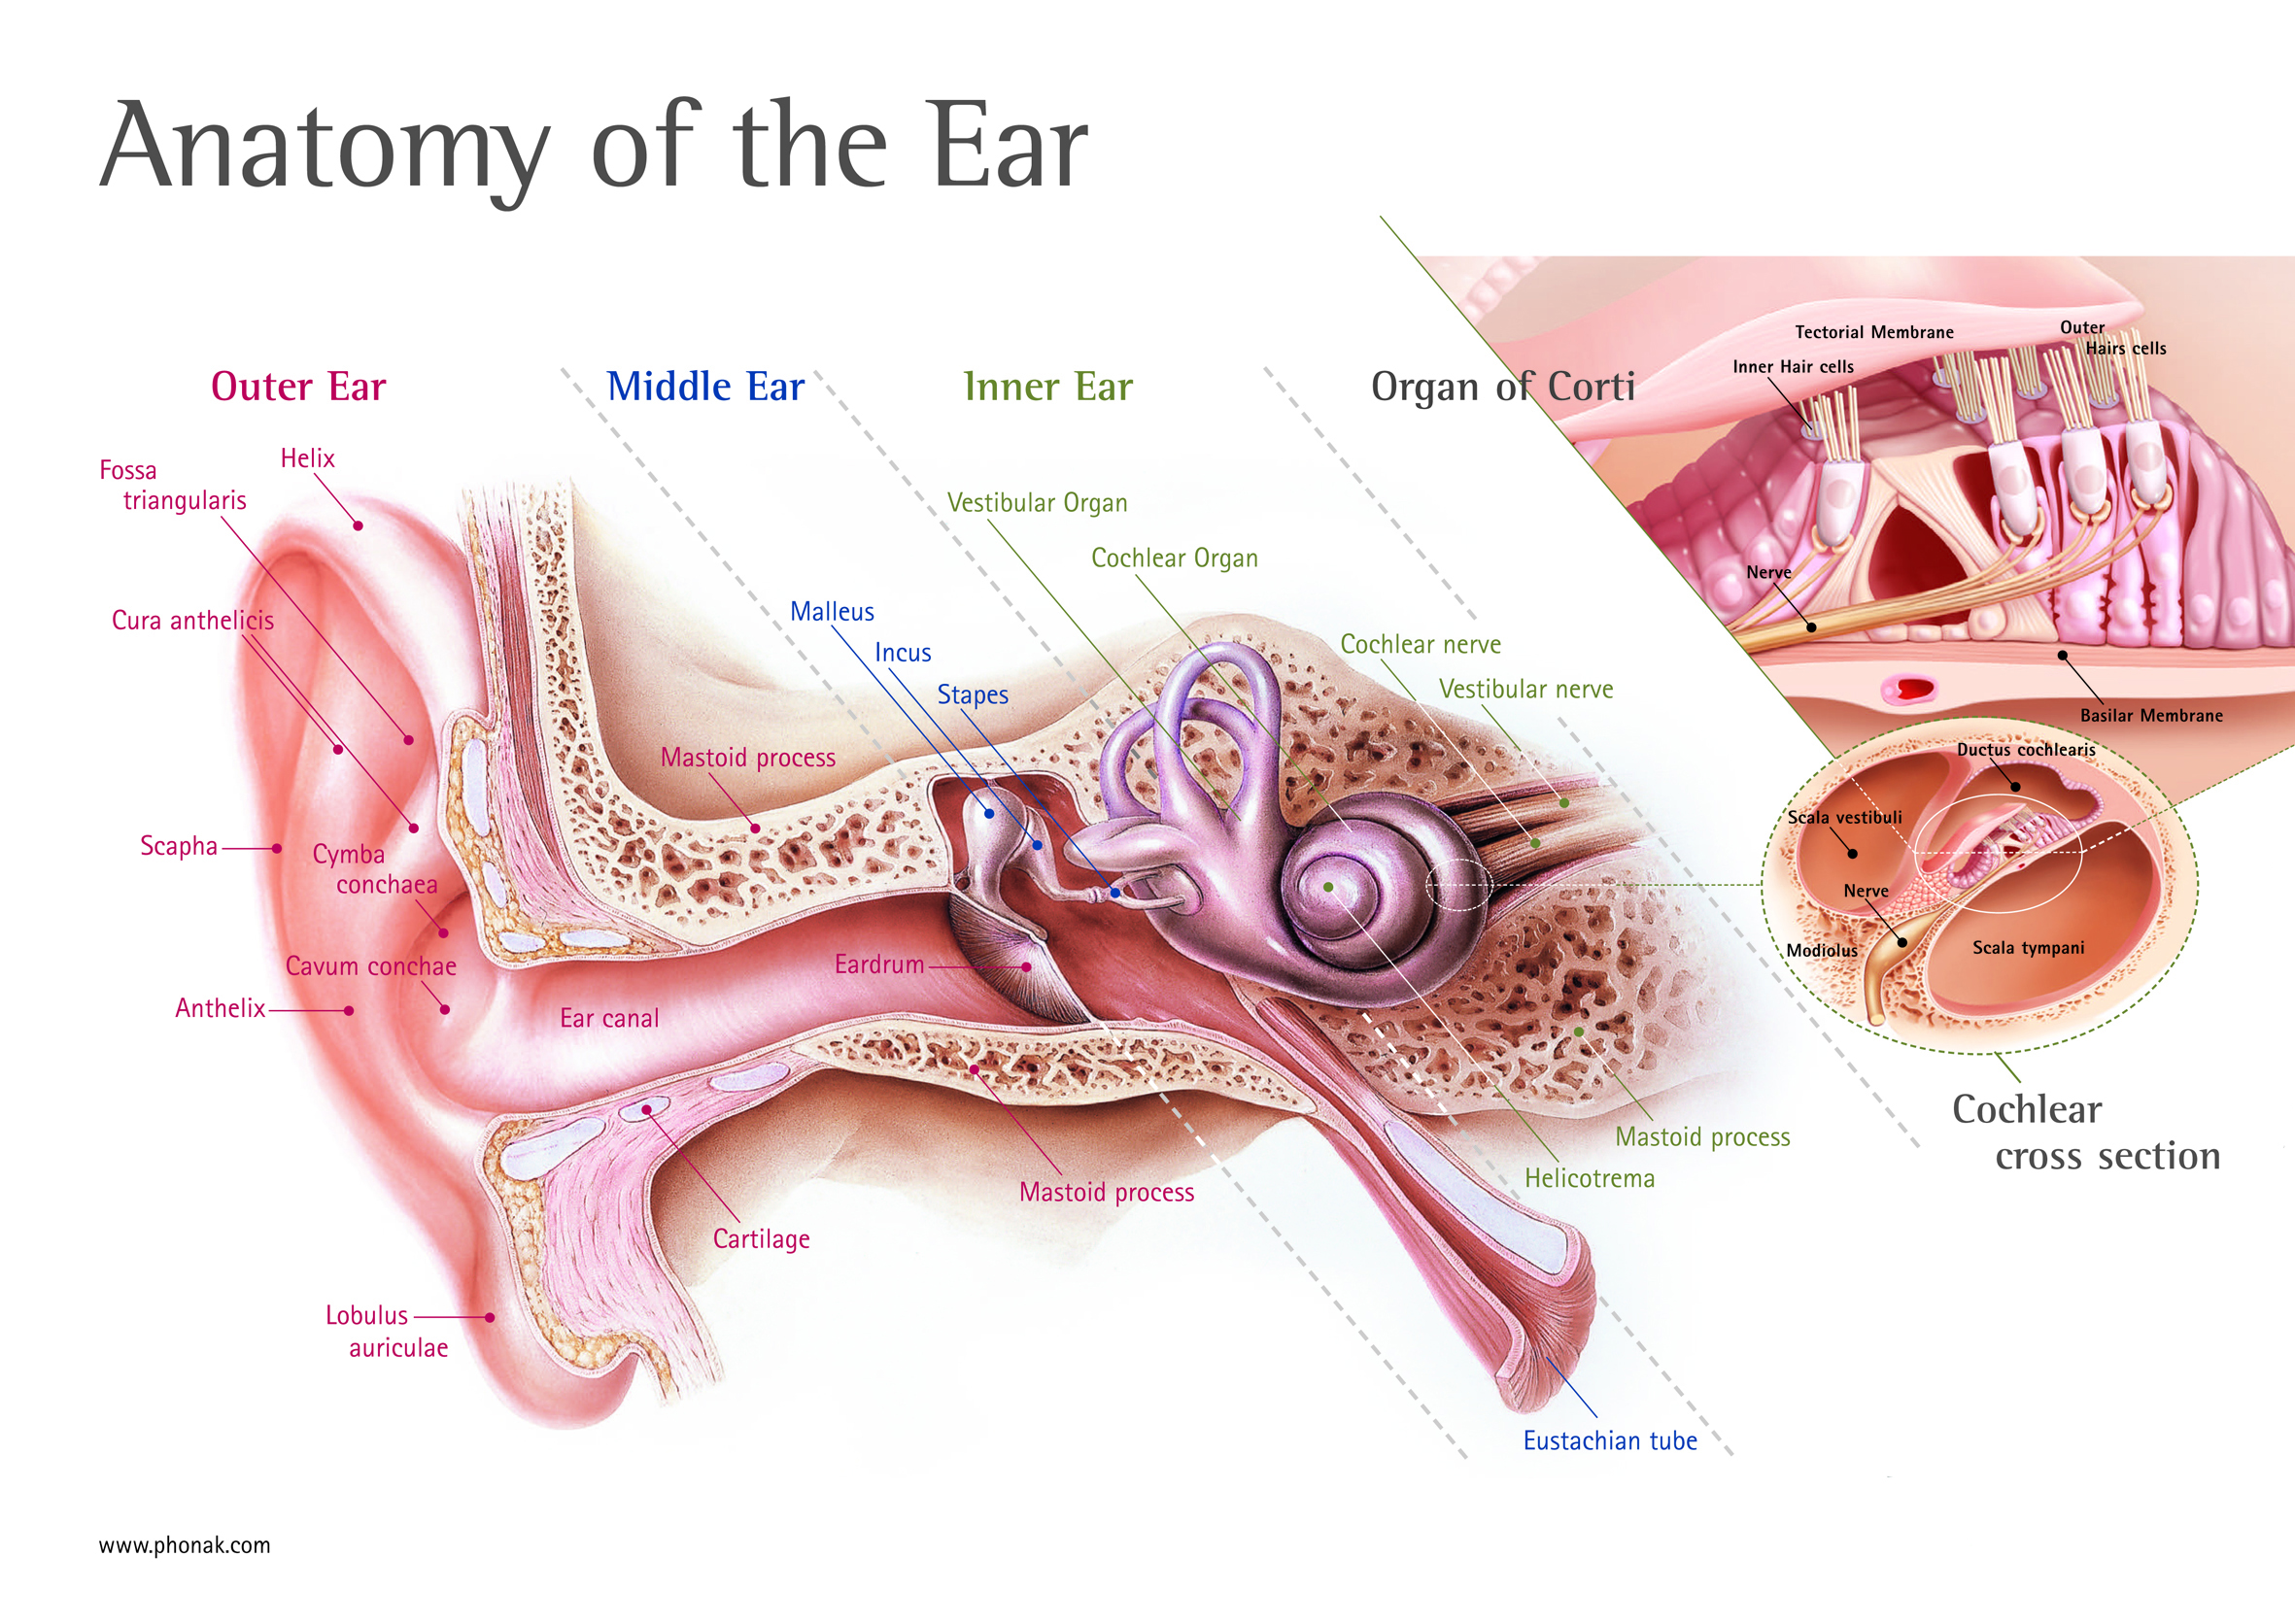

Slide 23
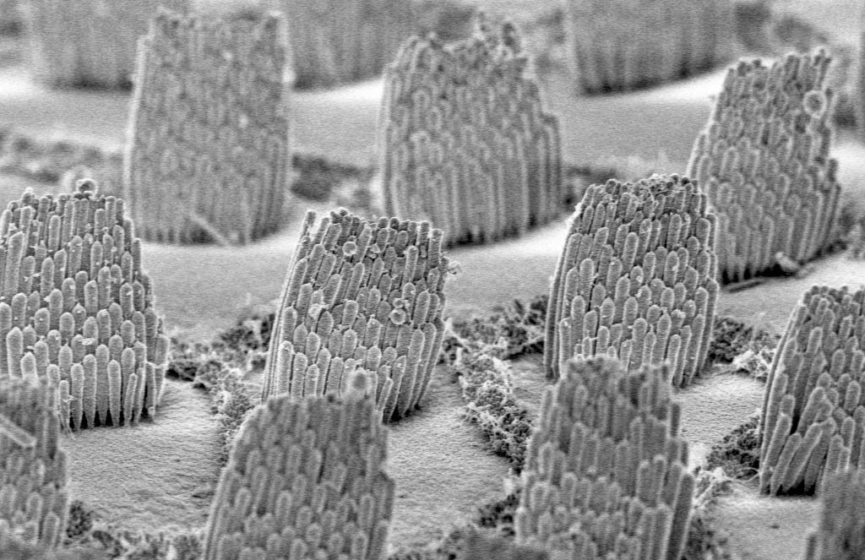

Slide 24
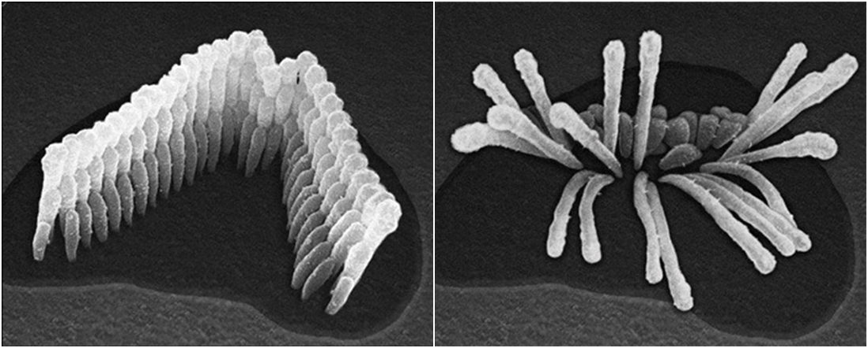

Slide 25
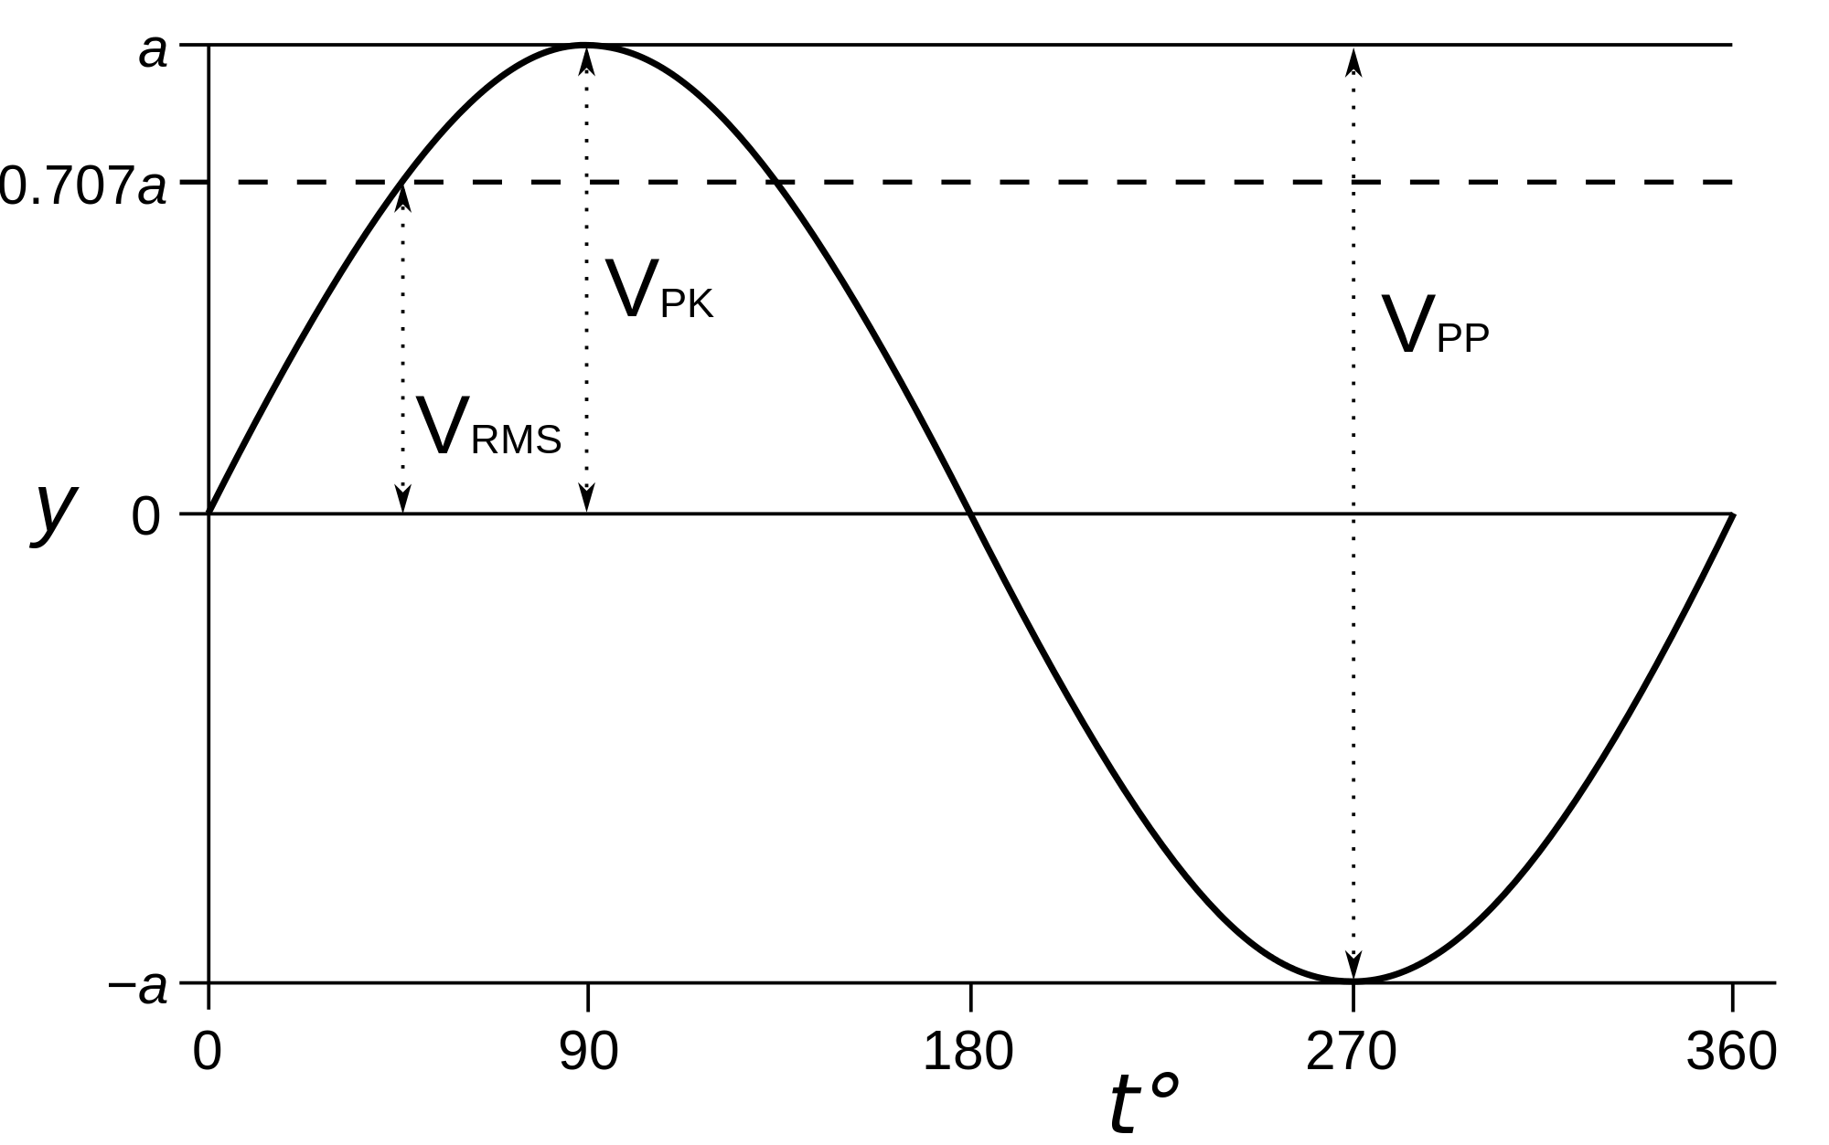

Slide 26
dB SIL: $L_{i}=10\log{\frac{I}{I_{0}}}$
$L_{2}−L_{1}=10\log{\frac{I_{2}}{I_{0}}}−10\log{\frac{I_{1}}{I_{0}}}=10\log{\frac{I_{2}}{I_{1}}}$
If $L_{2}=2L_{1}$, then $L_{2}−L_{1}=10\log{2}≈3$ decibels SIL
dB SPL: $L_{p}=10\log{\frac{I^{2}}{I_{0}^{2}}}=10\log{{\left(\frac{I}{I_{0}}\right)}^{2}}=20\log{\frac{P}{P_{0}}}$
Why? Because $I=P⋅v∝k⋅P^{2}$
$L_{2}−L_{1}=20\log{\frac{I_{2}}{I_{0}}}−20\log{\frac{I_{1}}{I_{0}}}=20\log{\frac{I_{2}}{I_{1}}}$
If $L_{2}=2L_{1}$, then $L_{2}−L_{1}=20\log{2}≈6$ decibels SPL
Phon: is one decibel at 1000 Hz
Sone: sound whose loudness is equal to 40 phons

Slide 27
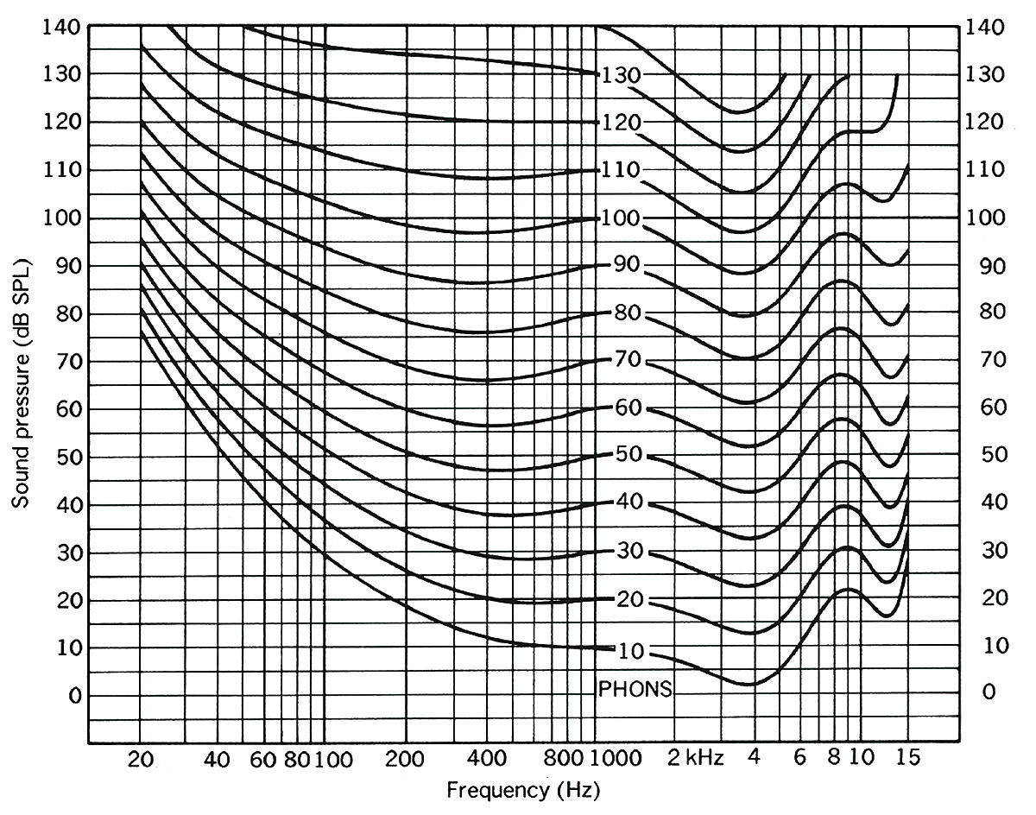

Slide 28
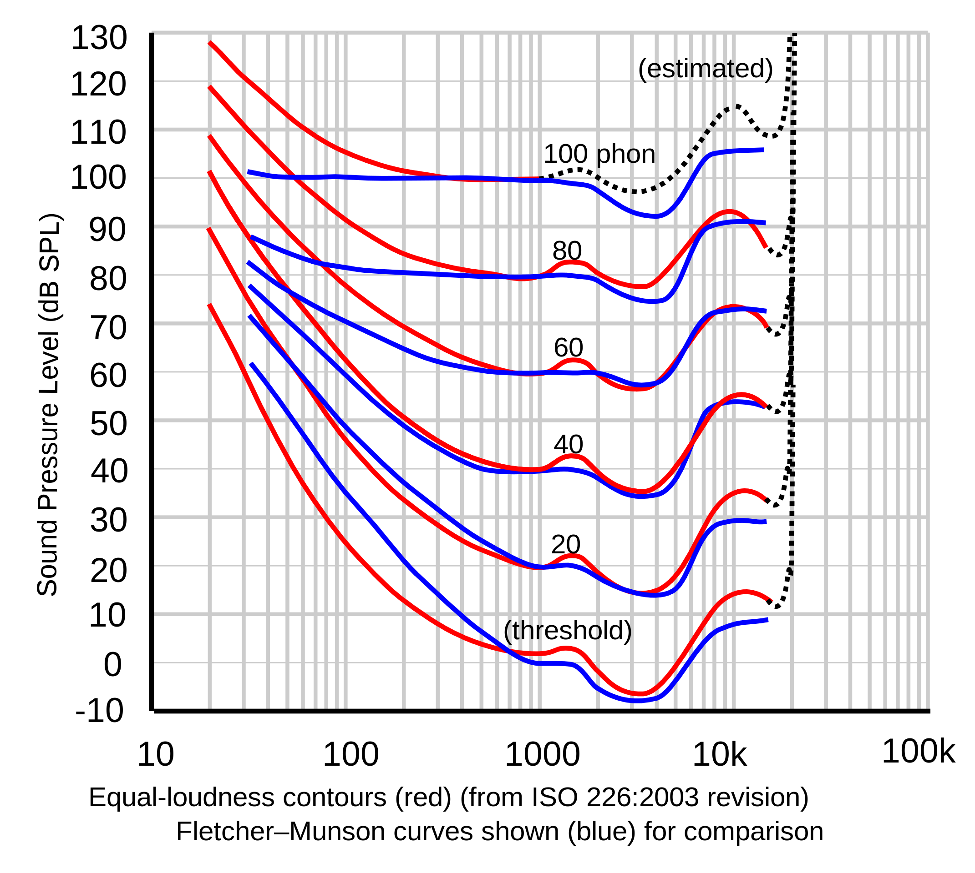

Slide 29
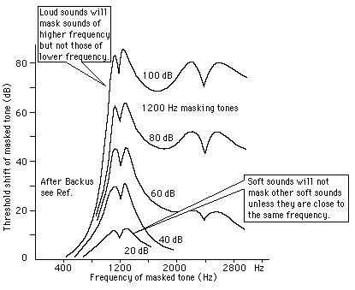

Slide 30
Chapter SIX
Tone Quality

Slide 31
Tone: sound that is long enough and steady enough for the ear to ascribe to it some characteristics, namely loudness, pitch and quality
Timbre: is the characteristic that can distinguish a sound from others with the same loudness and frequency
Pure tone: sound that contains only a single frequency, that is, contains no overtones
Complex tones: mixtures of simple tones of various amplitudes and frequencies
Partials: the individual pure tones making up a complex tone
Fundamental frequency: reciprocal of the longest period of a complex tone

Slide 32
Waveform: pattern of one cycle of a wave
Harmonics: partials whose frequencies are integer multiples of a fundamental tone
Harmonic series: the collection of all harmonic partials (up to infinity) of a given frequency
Intervals: ratios between frequencies; examples are octave (2:1) and fifth (3:2)
Relative phase: phase of a partial relative to the lowest partial
Remark: relative phase has little effect on the synthesis of sounds, but great effect on the re-synthesis of Fourier-analyzed sounds

Slide 33
Sawtooth wave:
$$f\left(t\right)=\sum_{n=1}^{∞}{\frac{\sin\left(2 πnt\right)}{n}}$$
Square wave:
$$f\left(t\right)=\sum_{n=1}^{∞}{\frac{\sin\left[2π\left(2n−1\right)t\right]}{2n−1}}$$
Triangular wave:
$$f\left(t\right)=\sum_{n=1}^{∞}{\frac{\cos\left[2π\left(2n−1\right)t\right]}{{\left(2n−1\right)}^{2}}}$$

Slide 34
Transient: the “attack” of a sound; transients are crucial to the identification of a sound source; noise is an important part of a transient
Formants: fixed frequency region in which harmonics are emphasized; Siri is an example of formant synthesis
Chorus effect: the slight detuning inherent to accumulating human sound sources of the same type and with the “same” frequency
Subjective tones: were believed to arise from nonlinearities of the inner ear, but are now believed to be entirely psycho-acoustical; aural harmonics and combination tones are the most conspicuous examples

Slide 35
Chapter Seven
Frequency and Pitch

Slide 36
Pitch: subjective property of sound used to compare frequencies
Audible range: in practical terms between 15Hz and 15kHz
Musical instrument range: between 27 and 4200Hz
Time and pitch: at 100 we need 0.04s, above 1kHz we need 0.013s to discern pitch
Amplitude and pitch: negligible and almost exclusive to pure tones
Medical conditions and pitch: diplacusis and even sinusitis

Slide 37
Medical conditions and pitch: diplacusis and even sinusitis
Pitch discrimination: up to 400Hz is roughly of 3Hz, above 1kHz stays at around 5Hz
Mel scale: 1000 mels = 1kHz; not relevant to musicians
Missing fundamental: discerning a fundamental frequency in the brain by its harmonic partials
Periodicity pitch: stronger form of combination tone heard up to 1500Hz
Absolute pitch: recently believed to be related to other losses such as that of facial recognition

Slide 38
Chapter eight
Intervals, Scales, Tuning, and Temperament

Slide 39
Interval: separation of two notes in a musical scale; also frequency ratios that depend on a temperament system
Pythagorean scale: is based on perfect fifths and given by
$$\left\{1,\frac{9}{8},\frac{81}{64},\frac{4}{3},\frac{3}{2},\frac{27}{16},\frac{243}{128},2\right\}$$
Pythagorean comma: is the ratio 531441:524288 that occurs at both ends of a Pythagorean scale
Just intonation: is obtained by picking low ratios in the harmonic series and given by
$$\left\{1,\frac{9}{8},\frac{5}{4},\frac{4}{3},\frac{3}{2},\frac{5}{3},\frac{15}{8},2\right\}$$
Just intervals: are given by
$$\left\{\frac{9}{8},\frac{10}{9},\frac{16}{15},\frac{9}{8},\frac{10}{9},\frac{9}{8},\frac{16}{15}\right\}$$

Slide 40
Syntonic comma: is the ratio between the Pythagorean thirds and the just-intonation thirds:
$$\frac{81}{64}÷\frac{5}{4}=\frac{81}{80}=\frac{6}{5}÷\frac{32}{27}$$
Just intonation: can be given in terms of a Pythagorean scale by adding or subtracting syntonic commas
$$\{0,−2,0,1,−1,0,−1,0,−2,−1,1,−1,0\}$$
Meantone tuning: is an attempt to correct the unpleasant thirds of the Pythagorean tuning, again given by syntonic commas
$$\left\{0,−\frac{7}{4},−\frac{1}{2},\frac{3}{4},−1,\frac{1}{4},−\frac{3}{2},−\frac{1}{4},−2,−\frac{3}{4},\frac{1}{2},−\frac{5}{4},0\right\}$$
Diesis: is the interval between G-sharp and A-flat in the meantone tuning that creates the wolf fifth between G-sharp and E-flat
Equal temperament: are the $(n−1)$-powers of an $n$^{th} root of two

